Slide 1


HUMAN-COMPUTER
INTERACTION
Usman Institute of Technology
FALL 2021
CS411 Human Computer Interaction
Lecture 13
Evaluation Techniques

Slide 2
In Last Lecture …
Task Analysis

Slide 3
In Today’s Lecture …
Introduction to evaluation
  What Evaluation is?
  Goals of Evaluation
  Significance and importance of evaluation
  Different paradigms
  Different techniques which constitute this paradigm

Slide 4
Evaluation
Users want interactive productive to be
  easy to learn, effective, efficient, safe, and satisfying to use.
  Being entertaining, attractive, challenging, and enjoyable is also important for the success of website, games, toys, and other consumer products.
  Achieving this requires the products to be evaluated

Slide 5
What is Evaluation?
To assess our design and test our system to ensure that they actually behave as we expect and meet user requirements
Evaluation should not be thought of as a single phase in design process
Evaluation should occur throughout the life cycle

Slide 6

Users
Provide input to
Provide feedback on usability to
Users
Provide bug report to
Designers
QA
Software
Development
Process
Provide mandate to
Provide spec to
Provide code to
Certify product for release
Managers
programmers
Primary responsibility:
Ensure financial success
Ensure customer satisfaction
Ensure performance
Ensure reliability
Initiate
Design
Code
Test
Ship

Slide 7
Goal-Directed Design Model
Research
User and the domain
Modeling
Users and use context
Requirements
Definition of user, business& technical needs
Framework
Definition of design structure & flow
Refinement
Of behavior, form& content

Slide 8
Goals of Evaluation
Assess extent and accessibility of system’s functionality
Assess effect of interface on user
Identify specific problems

Slide 9
Goals of Evaluation
Assess extent and accessibility of system’s functionality
Assess effect of interface on user
Identify specific problems

Slide 10
Goals of Evaluation
Assess extent and accessibility of system’s functionality
  Design of system should enable users to perform their intended tasks more easily.
  Example: if a filing clerk is used to retrieving a customer’s file by the postal address, same should be provided in the computerized file system.

Slide 11
Goals of Evaluation
Assess extent and accessibility of system’s functionality
Assess effect of interface on user
Identify specific problems

Slide 12
Goals of Evaluation
Assess effect of interface on user
  To assess the user’s experience of the interaction and its impact on him/her. This includes the aspect such as
    How easy the system is to learn
    Its usability and user’s satisfaction with it
    Enjoyment and emotional response
    Identify areas of design that overload the user by requiring an excessive amount of information to be remembered.

Slide 13
Goals of Evaluation
Assess extent and accessibility of system’s functionality
Assess effect of interface on user
Identify specific problems

Slide 14
Goals of Evaluation
Identify specific problems with design
  Caused unexpected results, or confusion among the users
  This is related to both functionality and usability of the design

Slide 15
Evaluation
The process of systematically collecting data that informs us about what it is like for a particular or group of users to use a product for a particular task in a certain type of environment

Slide 16
By adopting evaluation in development process you can save money and time.
Design should progress in iterative cycles of design-evaluate-redesign

Slide 17
“Iterative design, with its repeating cycle of design and testing, is the only validated methodology in existence that will consistently produce successful results. If you don’t have user testing as an integral part of your design process you are going to throw buckets of money down the drain”
- Tognazzini (Usability Consultant)

Slide 18
Some good reasons
Problems are fixed before product is shipped, not after.
The team can concentrate on real problems, not imaginary ones.
Engineers code instead of debating.
Time to market is sharply reduced.
Good product design that works for sales pitches.
- Tognazzini

Slide 19
Evaluation paradigms and techniques

Slide 20
Evaluation paradigms

Slide 21
In this lecture we identify four core evaluation paradigms:
(1) “quick and dirty” evaluations;
(2) Usability testing;
(3) Field studies; and
(4) Predictive evaluation.
Other people may use slightly different terms to refer to similar paradigms.

Slide 22
Quick and Dirty Evaluation

Slide 23
Usability Testing

Slide 24
Field Studies

Slide 25
Predictive Evaluation

Slide 26
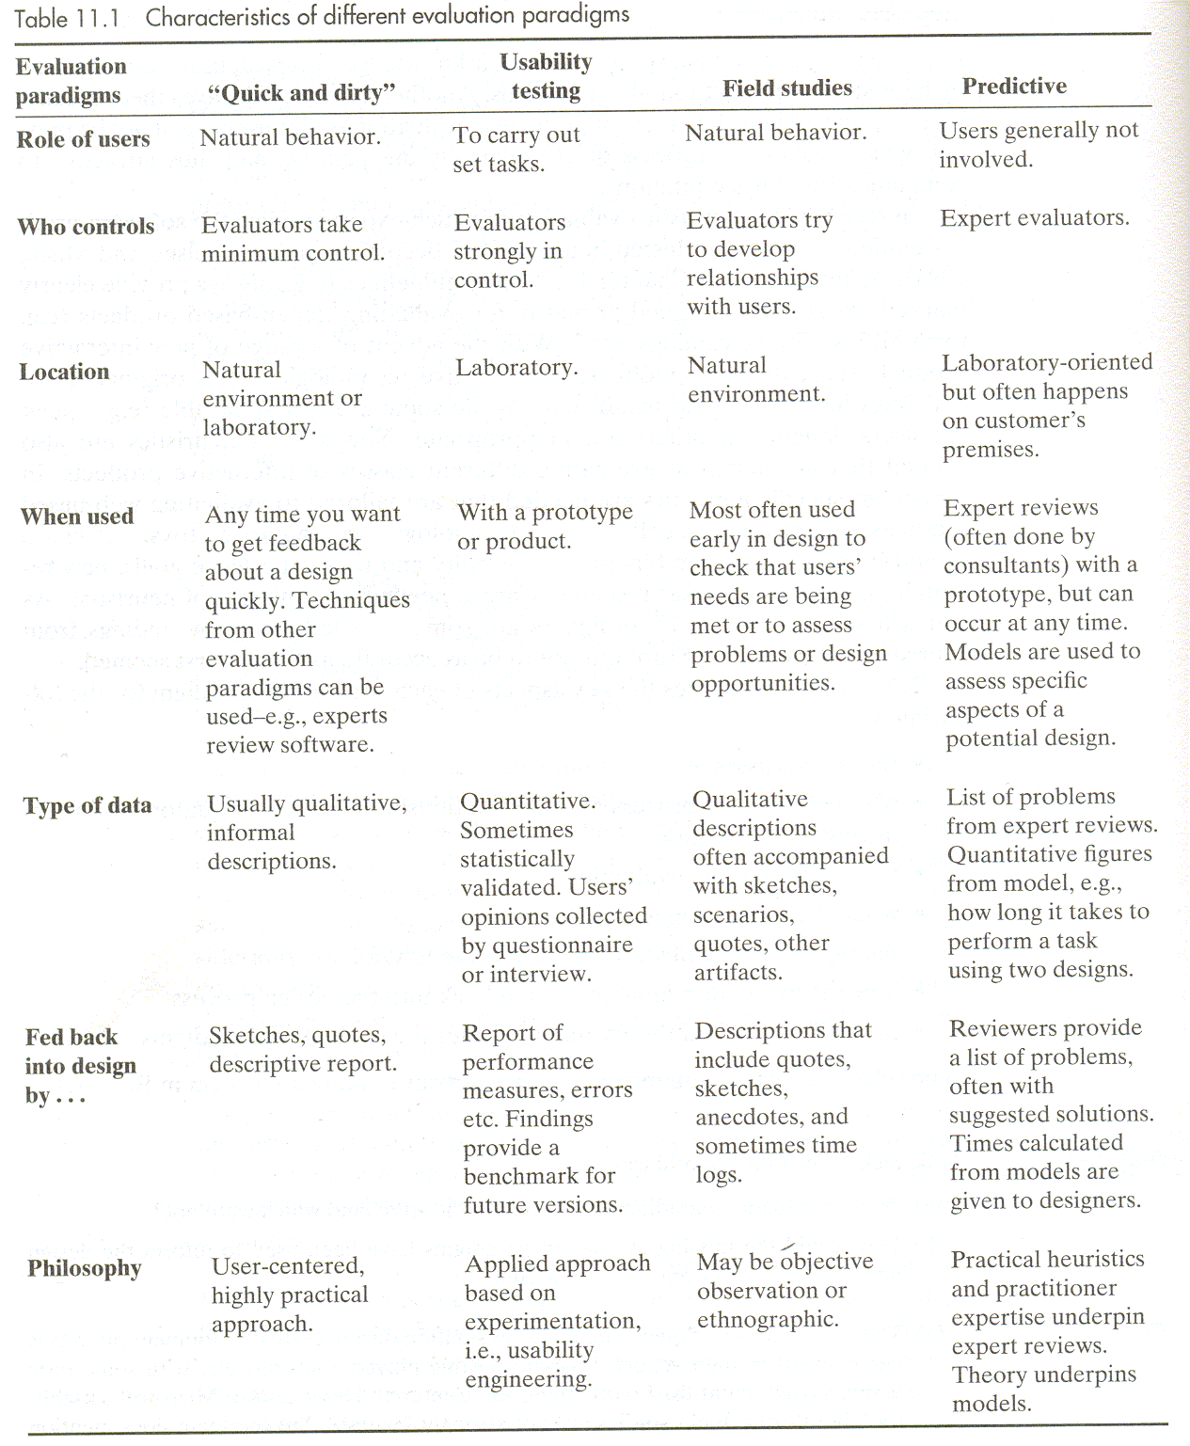

Slide 27
Interaction Paradigms
Techniques
  There are many evaluation techniques and they can be categorized in various ways, but in this lecture we will examine techniques for:
  Observing Users
  Asking Users
  Asking Experts
  Testing User Performance
  Modelling Users Tasks Performance

Slide 28
Observing Users

Slide 29
Asking Users

Slide 30
Asking Experts

Slide 31
Testing User Performance

Slide 32
  Modelling Users Tasks Performance

Slide 33
